Slide 1
Richard Brynteson, Skype and Teams MVP Web: theargylemvp.com Twitter: @rbrynteson GitHub: @rbrynteson
Microsoft Teams
The PBX of the Future

Slide 2

Welcome to the Fall Admin Workshop Day!
Please help us drive event awareness by tweeting and posting about your experience at the Workshop:
@o365MN #M365WorkshopDay
Please join us following the sessions for Happy Hour… Admin Ales, Workshop Wine, and more!

Slide 3







Thank You To Our Sponsors!
Remember to Stop by the Booths for “Vendor Bingo”

Slide 4
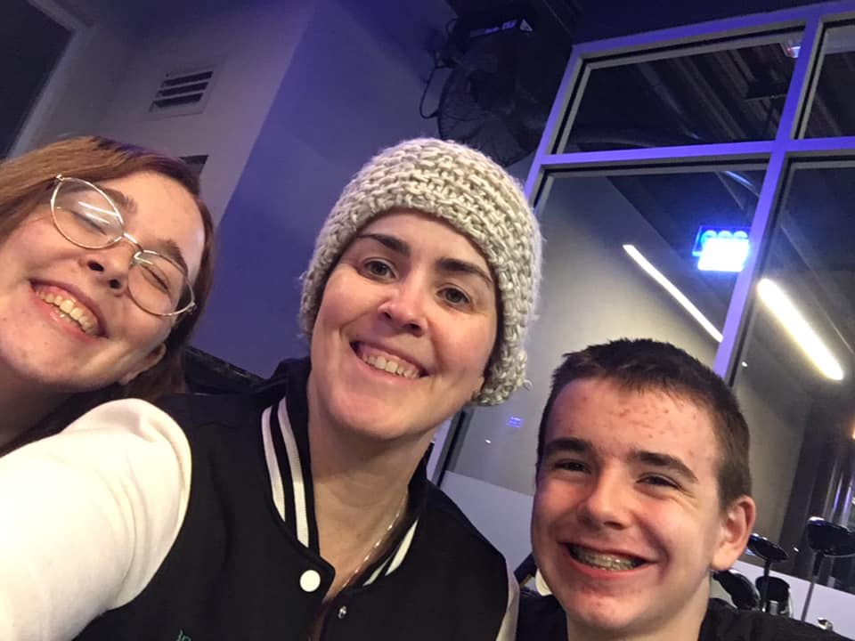
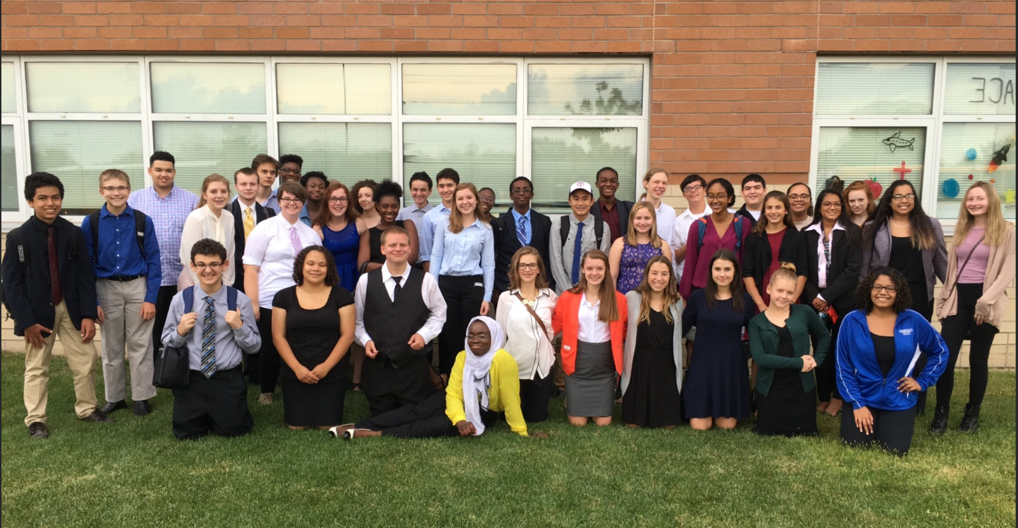
Introduction

Slide 5
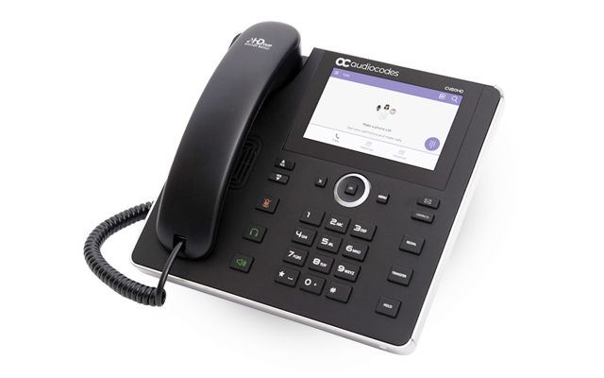
What are we going to discuss?
Features of Teams Calling
How do you connect to the PSTN?
Calling Plans
Direct Routing
Managing Teams Phone System
Advanced Routing
Is Teams Calling right for your organisation?

Slide 6
Features of Teams Calling

Slide 7
New Innovation in Teams Calling
Features
Shipped since January
Call Park
Voicemail settings in Teams Client
Share Microsoft Whiteboard (Preview)
Consultative Call Transfers
Shared Line Appearance
Phone System for GCC
Media Bypass for Direct Routing
Common Area Phone
Group Call Pickup
Oracle SBC Certification
Busy on Busy
Direct Routing Health dashboard
Shipped in last quarter
Delegation Enhancements
Calling Plans for Japan (Softbank)
Dynamic Emergency Calling for Calling Plans
Reverse Number Lookup
Calling in Chrome
Music on Hold
CQD Enhancements
Secondary Ringer
Futures
15% Discount for Phone System for on-prem SFB customers
Dynamic Emergency Calling in Direct Routing
Phone System Administration Enhancements
Auto Attendant Updates
Call Queues Updates

Slide 8
User Features
Features
Softphone and Physical Phone
Hold and Transfer
Caller ID
Cloud Voicemail
Escalate call to conference
Distinctive Ring
Delegation
Call forwarding / Sim ring
Call Park
Busy on Busy
Shared Line Appearance

Slide 9
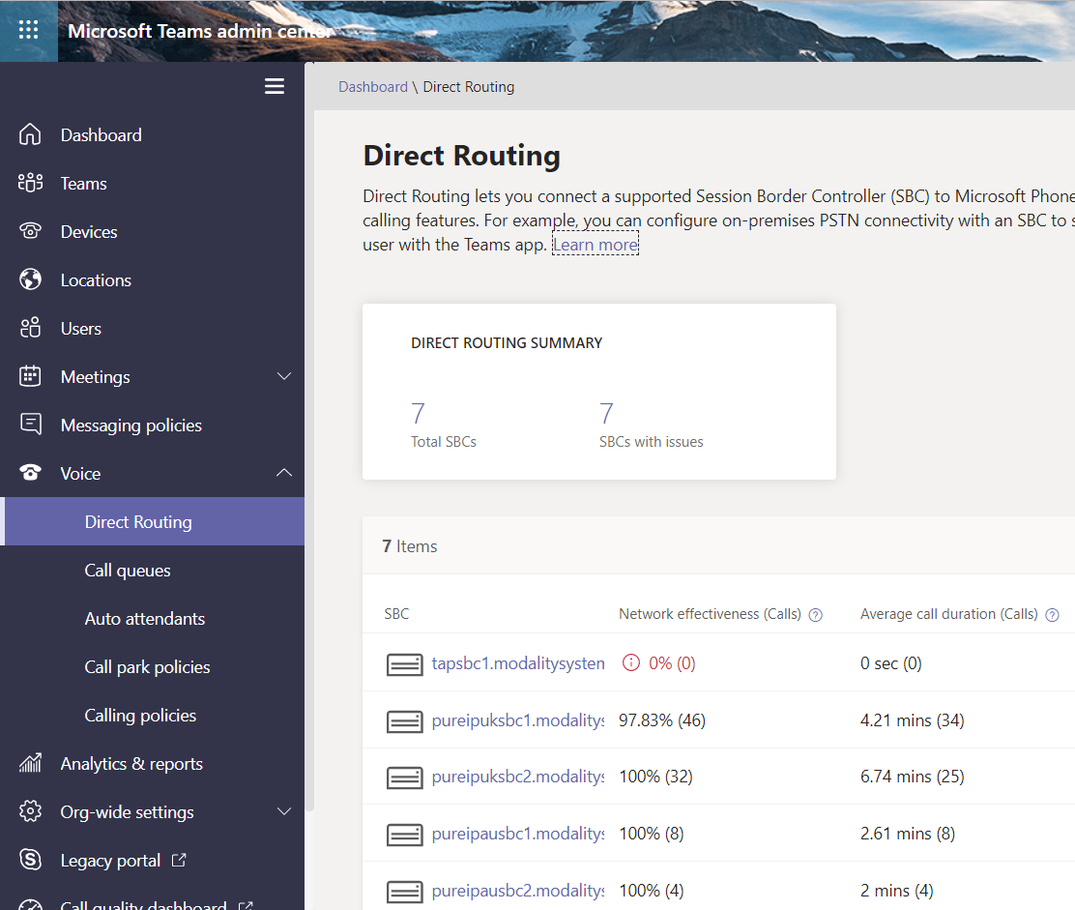
System Features
Features
Web and PowerShell Admin
Cloud Auto Attendants
Cloud Call Queues
PSTN via Calling plans and Direct Routing
Location Based Routing
Change/block outbound Caller ID
Reporting - Call Detail Records and Quality Reporting

Slide 10
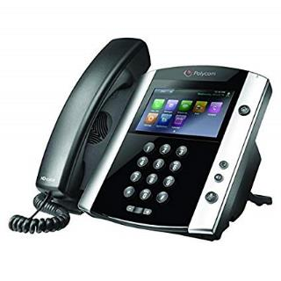
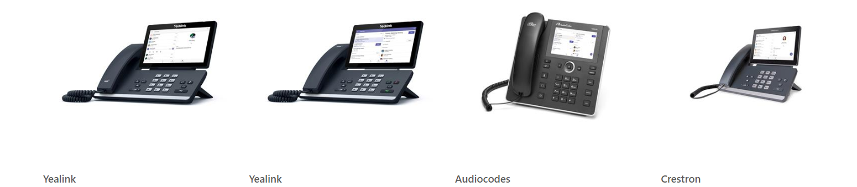
Phones
Supports Existing SfB 3PIP Phones
Via cloud gateway
Limited functionality
Native Teams Devices
New generation of phones with Teams client
Client by Microsoft
Managed through Teams Admin Center

Slide 11
Considerations and Gaps
Feature gaps
Unassigned number
User Music on Hold
VDI
IP Phone Features – Line keys, speed dials, function buttons
Highly granular RBAC for admin
API coverage (third party interop, billing, performance reports)
** Toast RNL is only for user local contacts
** Call/Session Recording
** Ignite
Features may have the same name but a different workflow will users change behavior?
Teams defaults to full screen
Map existing PBX usage to Teams features, what features are actually used?

Slide 12
How do I connect to the PSTN?

Slide 13
Microsoft Teams Calling
Microsoft 365
The hub for teamwork
Microsoft Teams
Phone System, when paired with Microsoft Calling Plans and/or Direct Routing, provides a full enterprise calling experience for Office 365 users in Teams on a global scale
PBX
Phone System
PSTN dial tone
Microsoft Calling Plans
Direct Routing in Teams
(Telco Calling Services)

Slide 14

Microsoft Calling Plans
Bring the benefits of the cloud to your phone system
Rapid provisioning Procure and assign phone numbers in minutes with no on-premises equipment
Number porting and Dynamic Emergency Calling Use your existing phone numbers with Microsoft calling plans, and meet E-911 and other legal obligations
Local, long distance and intl calling Reach the people important to your business, with a choice of calling plans
*Preview customers only. See details here.

Slide 15
Microsoft Calling Plans
Use Microsoft Teams Calling.
Calling Plans in 12 different countries
Mix and match direct routing if needed as you need
Canada
United Kingdom
Netherlands
Ireland
Germany
Belgium
United States
Spain
France
Puerto Rico
Japan (Softbank)
Australia (Telstra)

Slide 16
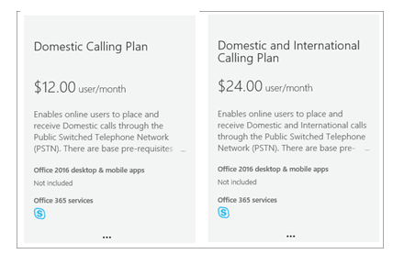
Microsoft Calling Plans
Requires porting numbers to Microsoft
Fully managed and provided by Microsoft
Need Phone System License
Included with an E5
$8 Charge for E1/E3 Customers
$4 Audio Conferencing for E1/E3 Customers

Slide 17
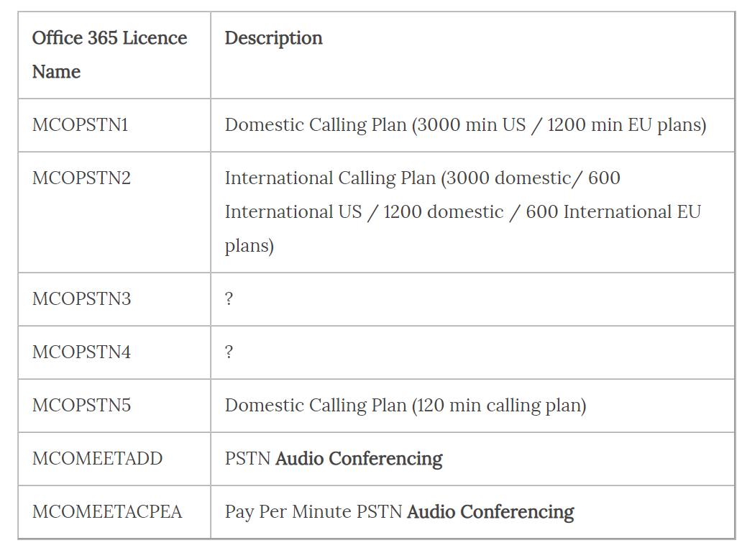
Microsoft Calling Plans – how do the minutes work
Options for Domestic and Domestic and International Plans
Minutes are pooled by same plan type and country
All users in that plan+country share the pool
Only outbound PSTN calls count against minutes
“overrun” will use Communications Credits (if setup)
Premium rate numbers may be blocked or charged extra – varies by country

Slide 18
Direct Routing
PSTN
Provider
Certified Session Border
Controller(s)
Phone #
Ranges
Internet
Phone System
Voice Trunk
Office 365 & Teams
Direct Routing in Office 365 allows customers to connect their SIP trunks directly from their network. Customers can work with their local Telecommunications provider to enable Microsoft Teams users to make and receive telephone calls.
Direct Routing allows customers with users in the Microsoft cloud to continue using 3rd party systems such as PBXs, Call Center, and Analog Telephony Adaptors (ATA) helping preserve key investments.

Slide 19
Direct Routing – In Depth
Bring your own carrier
Must be certified SBC’s for support
Now supports Cloud AA and CQ
Deployment Models:
Physical SBC’s or Cloud hosted SBC’s
Carrier Managed service
limited interop with existing systems
routes over internet
Dedicated Managed Service
Run your own SBC’s in house
Consider Public IP and Certificate requirements
Why?
Global coverage
Keep carrier relationship/contract)
Interop with existing systems (PBX, Paging, Analog devices, alarm, lift, local fax)
Considerations
Maybe use some service numbers to cover you if there is a direct routing issue
Maybe have some Calling plan users just for testing

Slide 20
Direct Routing
PSTN
Provider
Certified Session Border
Controller(s)
Phone #
Ranges
Internet
Phone System
Voice Trunk
Office 365 & Teams
Existing PBX
Call Center
Analog Gateway

Slide 21
Bring it all together
- New-CsOnlinePSTNGateway -Identity sbc.domain.com -Enabled $true -SipSignallingPort 5067 -MaxConcurrentSessions 100
- Set-CsOnlinePstnUsage -Identity Global -Usage @{Add="T2M"}
- New-CsOnlineVoiceRoute -Identity T2M -NumberPattern "\d+" -OnlinePstnGatewayList sbc.domain.com -Priority 1 -OnlinePstnUsages "T2M“
- New-CsONlineVOiceRoutingPolicy -Identity "T2M" -OnlinePstnUsages "T2M“
Run For Each User
- Set-CsUser sfb.user@domain.com -OnPremLineURI tel:+12039307408 -EnterpriseVoiceEnabled $true -HostedVoiceMail $true
- Grant-CsOnlineVoiceRoutingPolicy sfb.user@domain.com -PolicyName T2M

Slide 22

Dynamic 911 Services
Calling Plans now have two options
Static configuration at the phone number
Dynamic configuration based on network

Slide 23
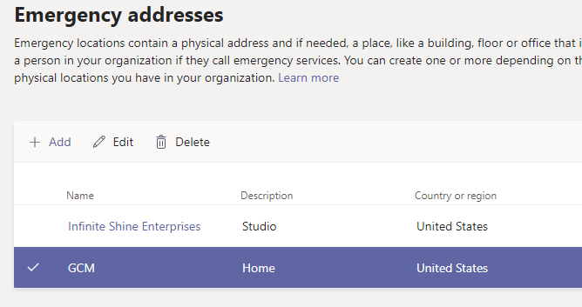
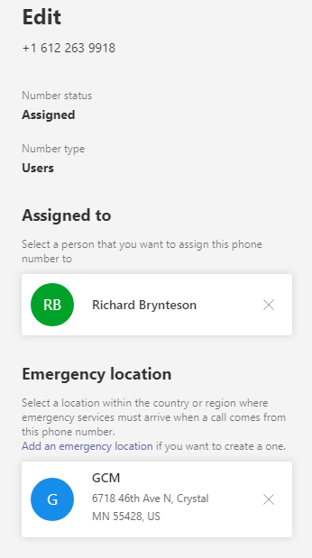
Static Configuration
Phone Numbers are associated to Emergency addresses

Slide 24
Dynamic Configuration
Configured based on network identifiers such as Subnet and Wireless Access Point. Support for port level is pending.
Get, Set, Remove -CsOnlineLisPort
Get, Set, Remove -CsOnlineLisSwitch
Get, Set, Remove –CsOnlineLisSubnet
Get, Set, Remove -CsOnlineLisWirelessAccessPoint

Slide 25
Dynamic Configuration (Cont)
Create Emergency Calling Policies for notifications. Chat, Conference or Muted Conference.
Emergency policy is then associated with network site. Additionally, can be associated with users.

Slide 26
Direct Routing + Dynamic Configuration
Emergency Call Routing Policy (where to call).
Use the before mentioned Emergency Policy and Network configuration to determine which SBC to send the call to.
https://docs.microsoft.com/en-us/microsoftteams/manage-emergency-call-routing-policies

Slide 27
Managing Teams Phone System

Slide 28
Admin Center Demo

Slide 29
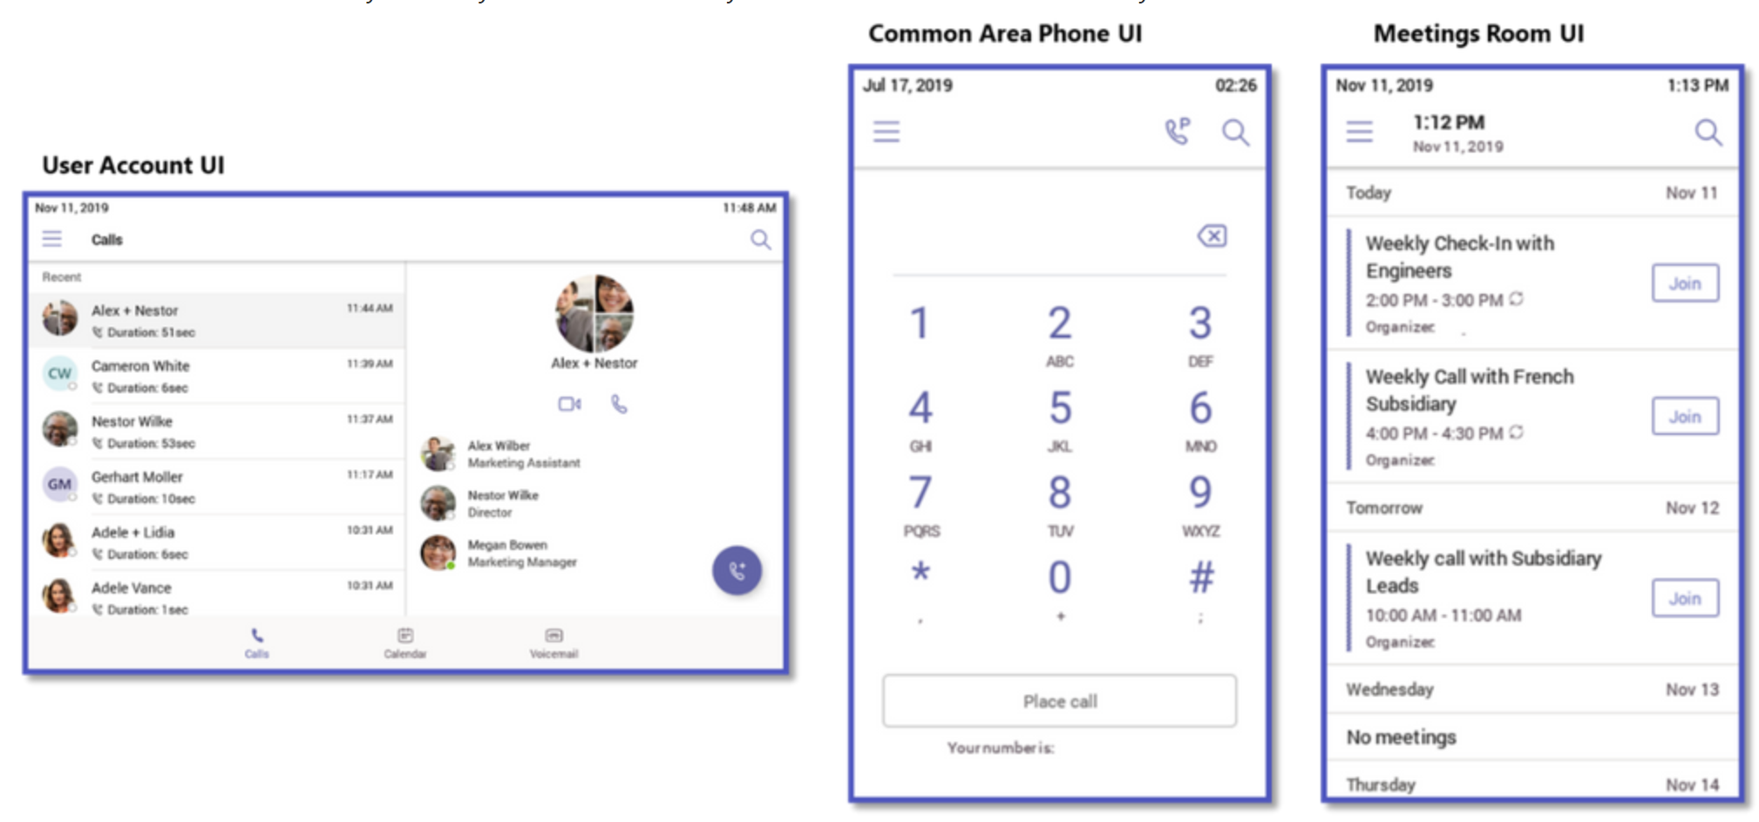
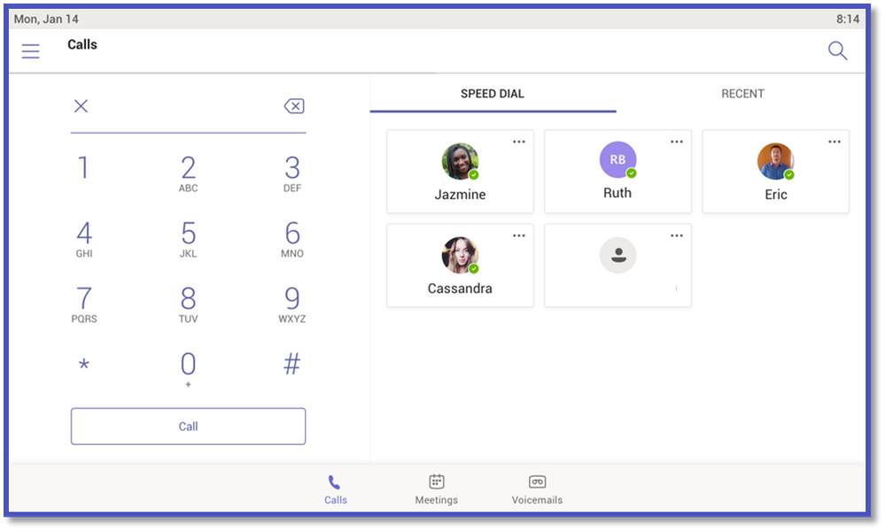
More Phone Features
More Devices
Customize UI Based on Type
Hot Desking
911 Enhancements /
Dynamic 911
Early 2020
Speed Dial and Boss Admin

Slide 30
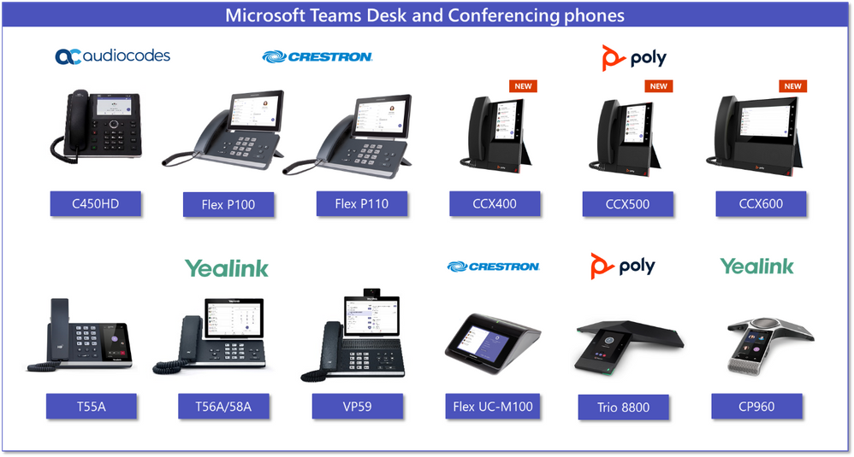

Slide 31
How do calls route in Microsoft Teams?

Slide 32
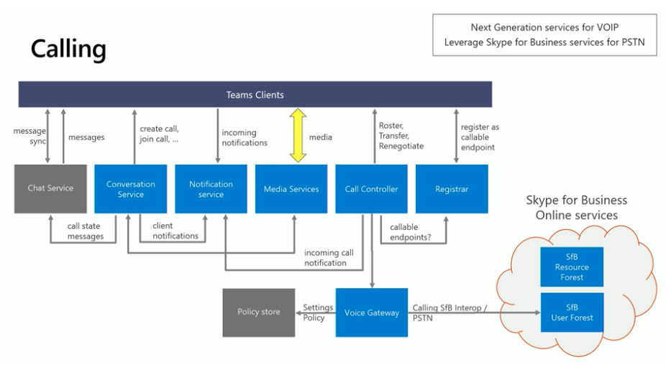
Built on the Success of Skype for Business

Slide 33
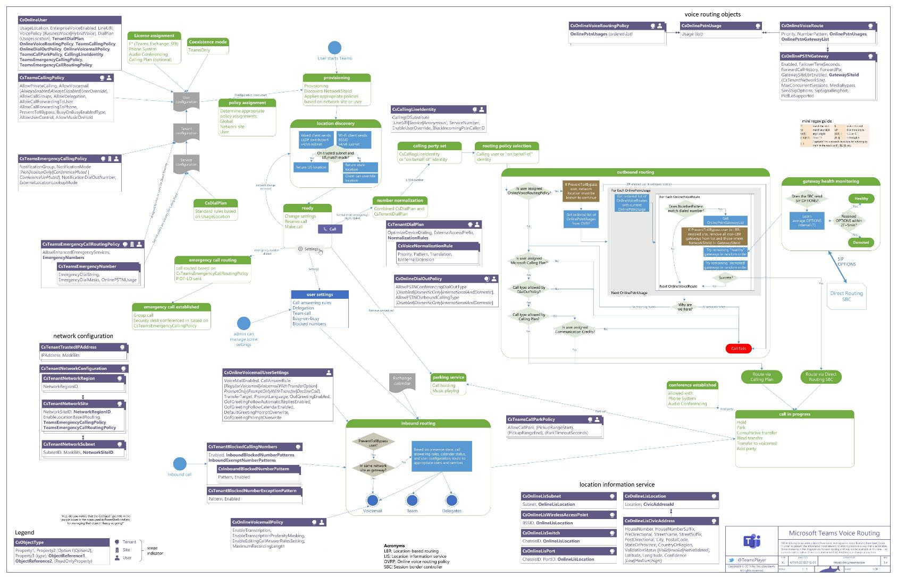

Slide 34
Teams & Complex Routing
Supports multiple dial plans
Supports multiple gateways and trunks
Very flexible with Direct Routing, just no GUI

Slide 35
Is Microsoft Teams telephony right for your organisation?

Slide 36
Where is Teams + Business Calling A Good Fit
Cloud first customers
Already have Microsoft plan / Microsoft direction
Knowledge workers / mobile workers
Greenfield

Slide 37
Where is Teams Phone System may not fit
Customer wants a classic phone system and is not interested in collaboration or softphones/mobile
Specific SLA/local survivability requirements
Specific feature requirements – recording, line keys, very specific workflows
Remember, it’s not all or nothing, you can move select users in an organisation

Slide 38
Like This Content
Teams Users Group Meetings
https://www.meetup.com/MNTeams/
Next Meeting: December 19th at 9:00 AM / MTC

